Slide 1
Colossal Avian Changes
8/13/2024
Matthew Zhang

Slide 2
Lightweighting

Slide 3
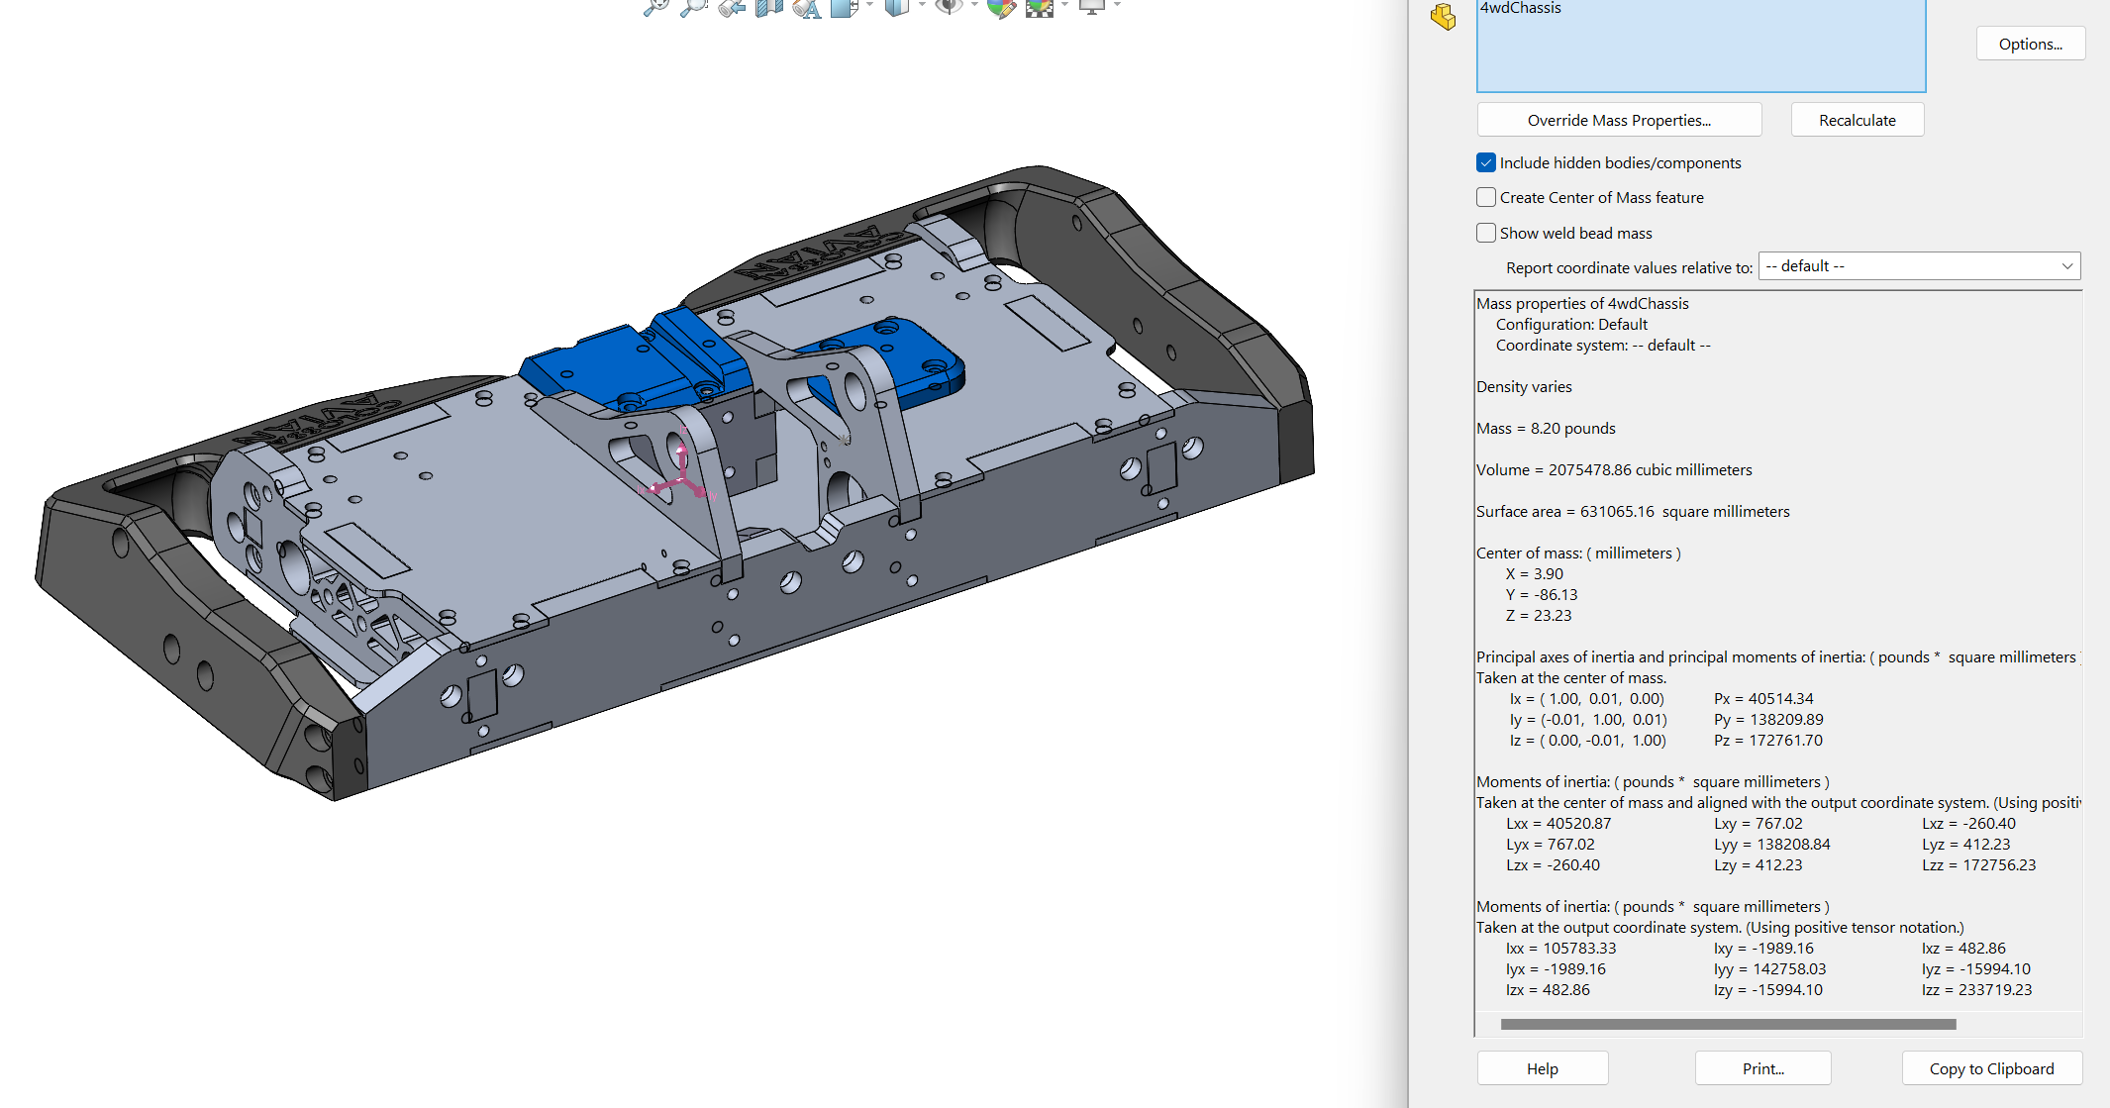

Slide 4
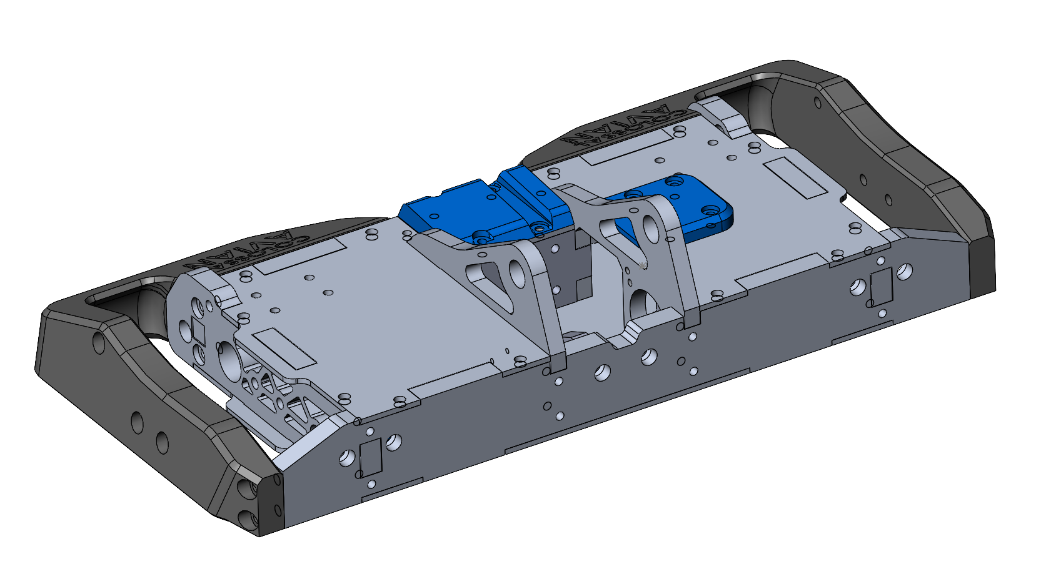
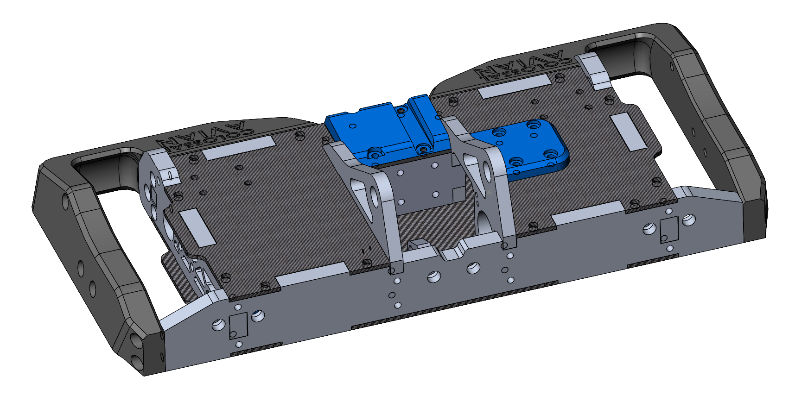
CF Plates
AL top/bottom plate mass: 1.71 lb
CF top/bottom plate mass: 0.95 lb
(could get more from cutouts)
Net: 0.76lb

Slide 5
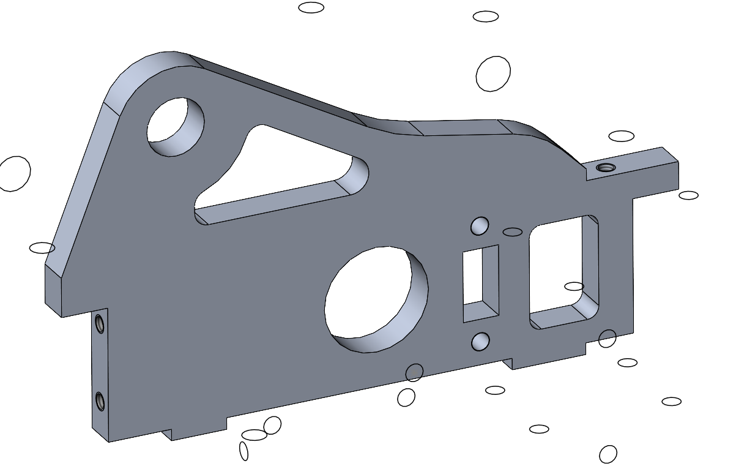
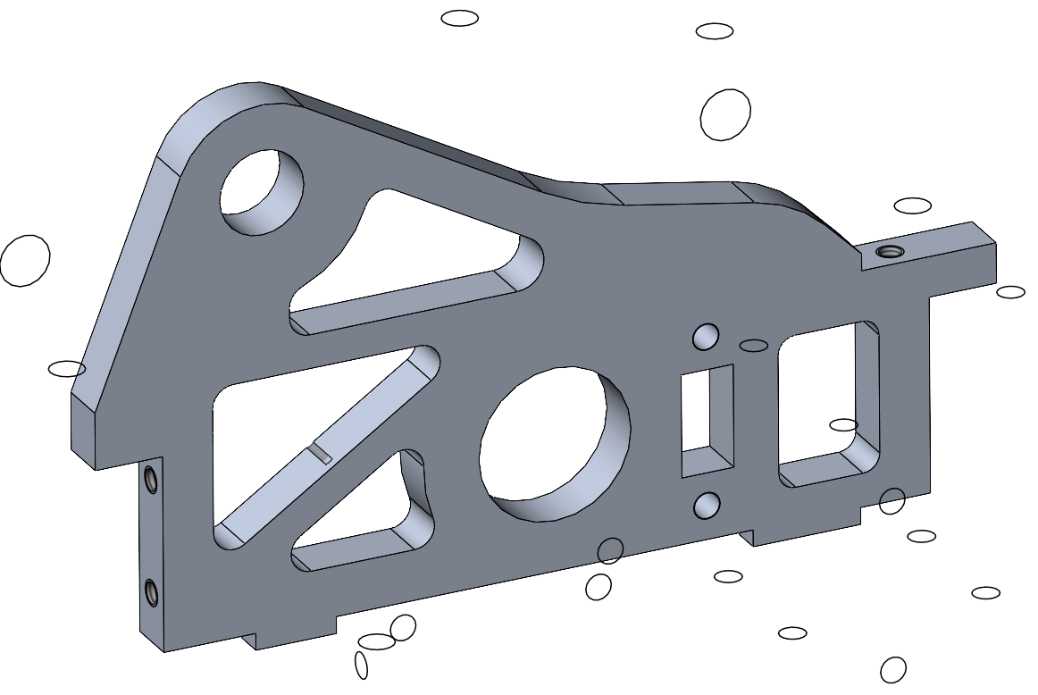
Upright
0.43 lb
0.5 lb

Slide 6
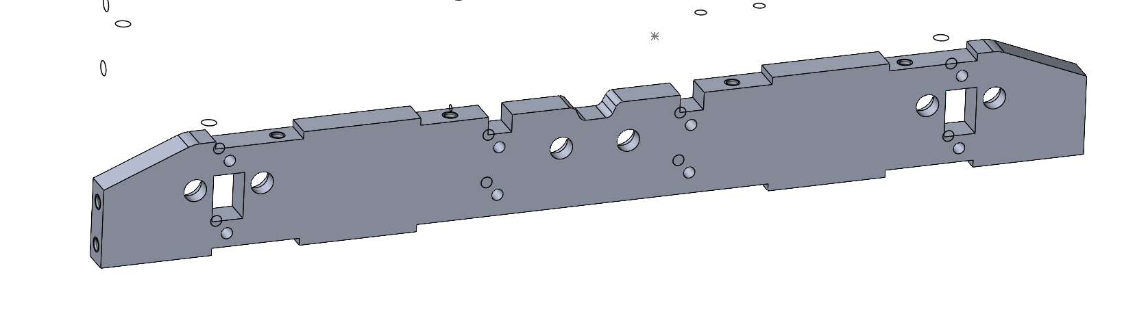
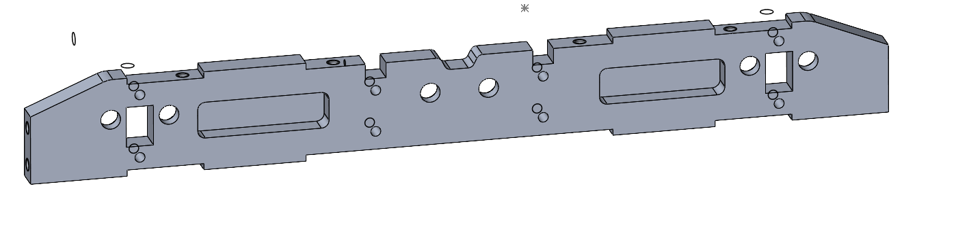
Front Plate
1.33lb
1.19lb

Slide 7
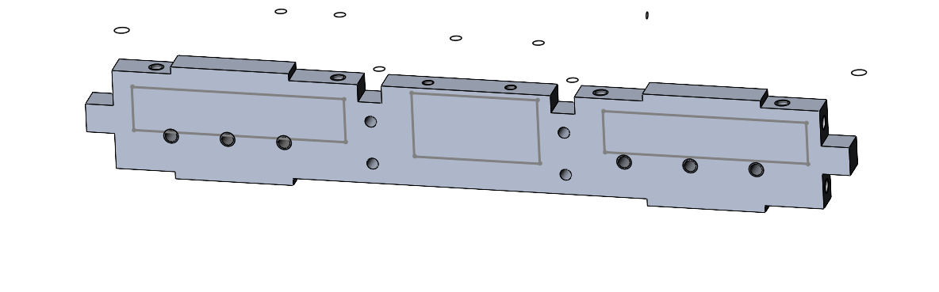
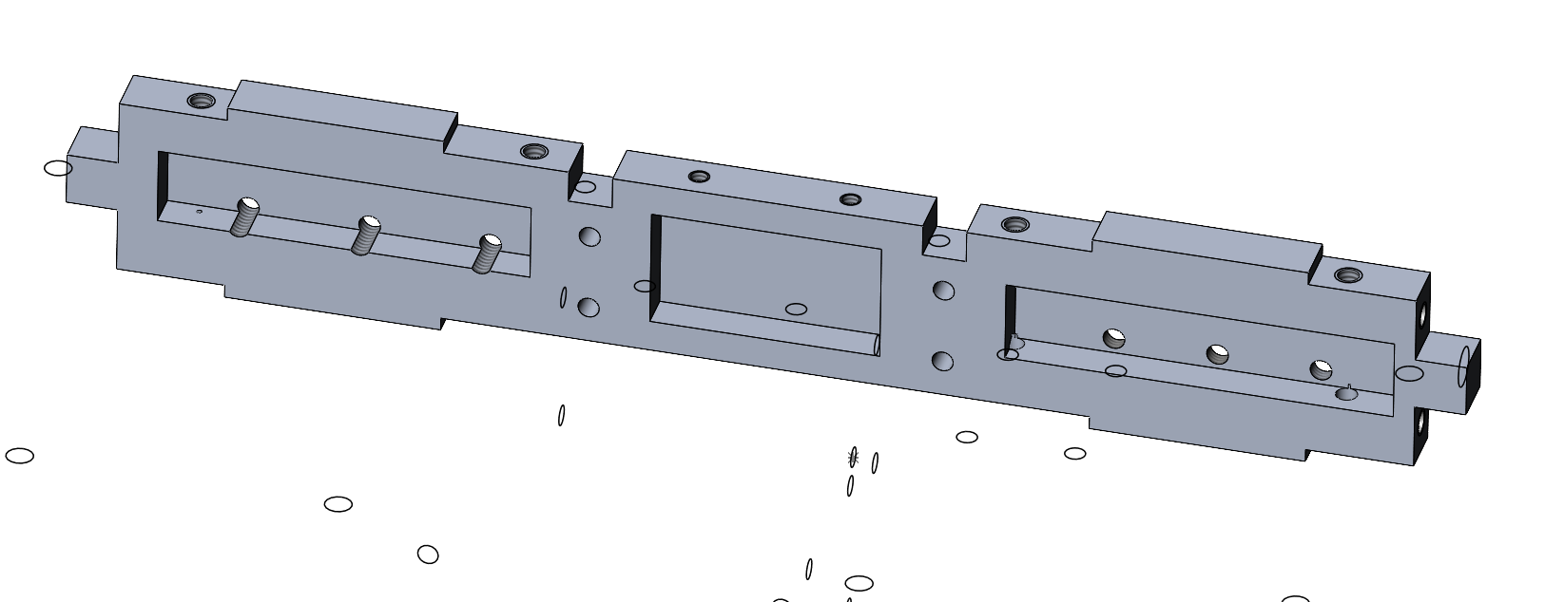
1.05 lb
.79 lb

Slide 8
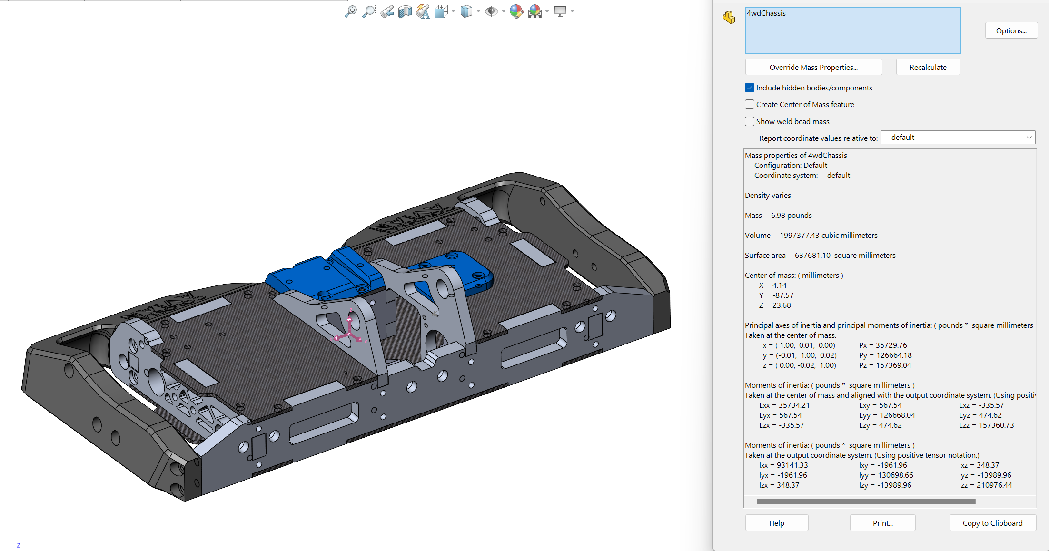
Chassis Net Weight savings
8.2lb -> 6.98 lb = 1.22lb saved

Slide 9
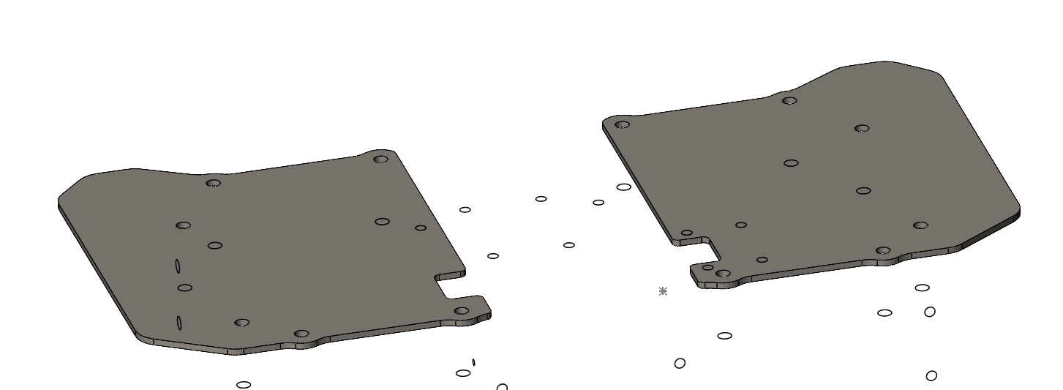
Top Armor
AR500: 2.81lb
Ti Grade 5: 1.67lb
Note: Can we run w/out wedge when we decide to run top armor to make weight?

Slide 10
Motor Selection

Slide 11
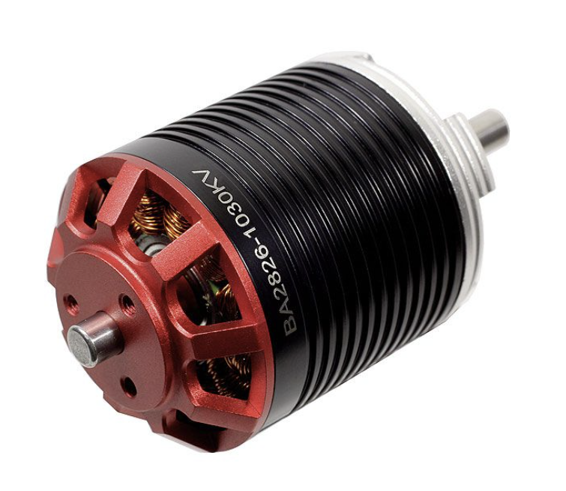
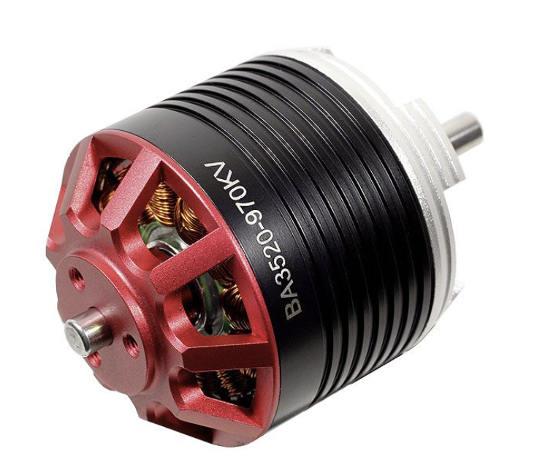
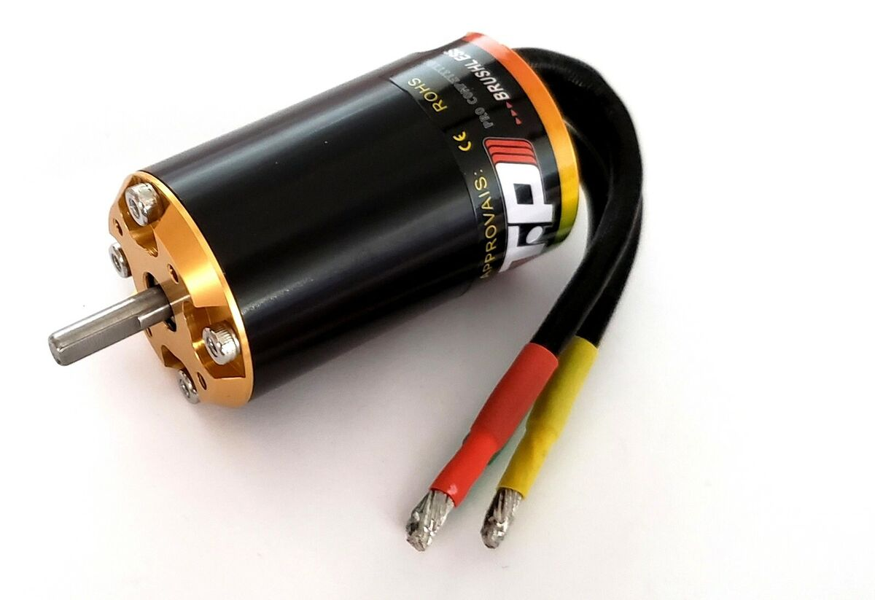
Stats
 | BA2826 1030 KV (Baseline) | BA3520 970 KV | TP 3630
Diameter (mm) | 35.6 | 43.5 | 36
Length (mm) | 46 | 46 | 60
Weight (g) | 181 | 224 | 252
Continuous Power (W) | 1550 | 2000 | 900 (1800 max)

Slide 12
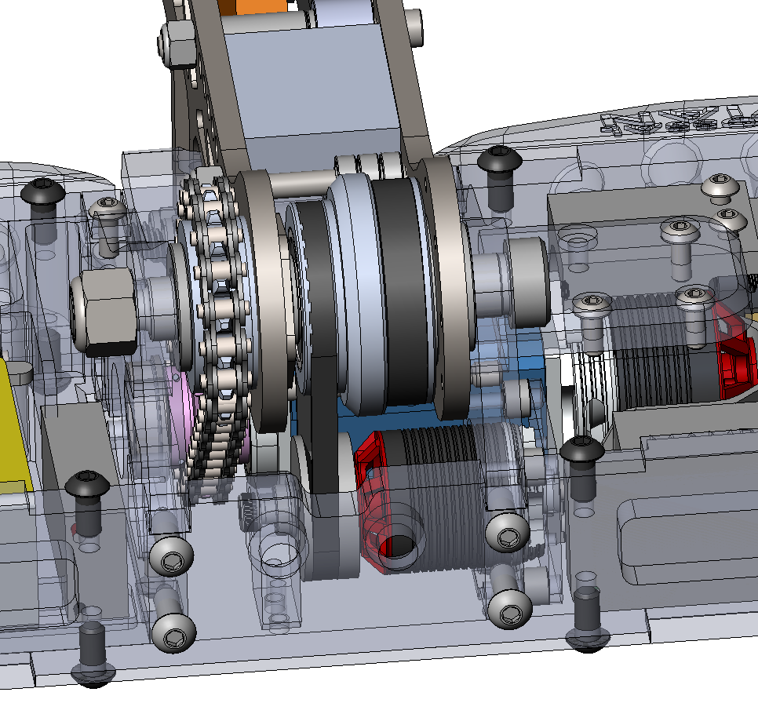
Package (Baseline)

Slide 13
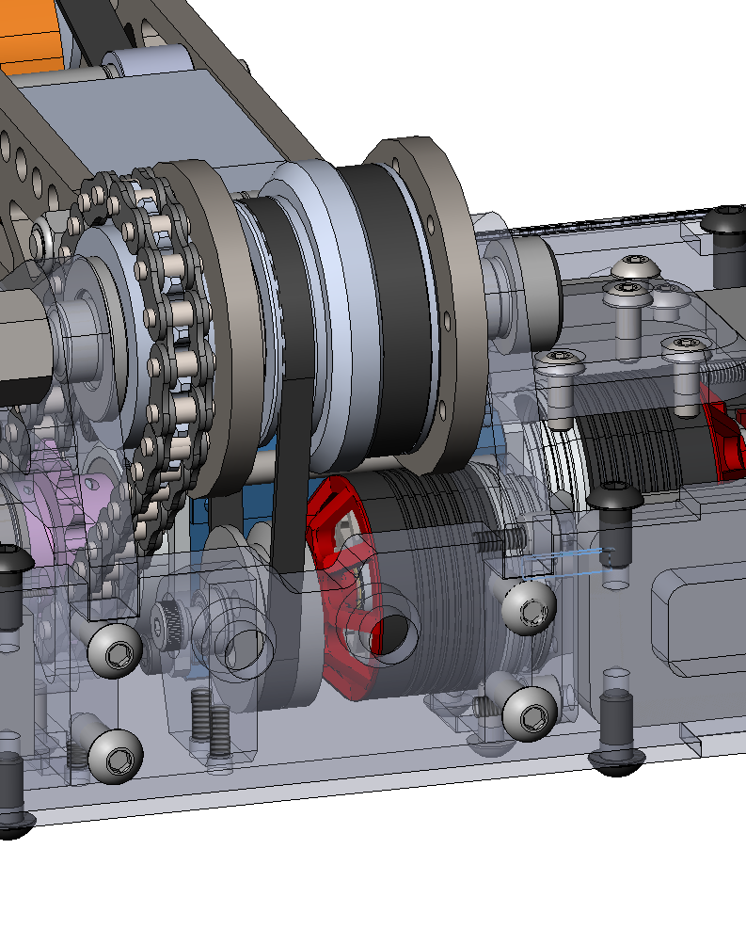
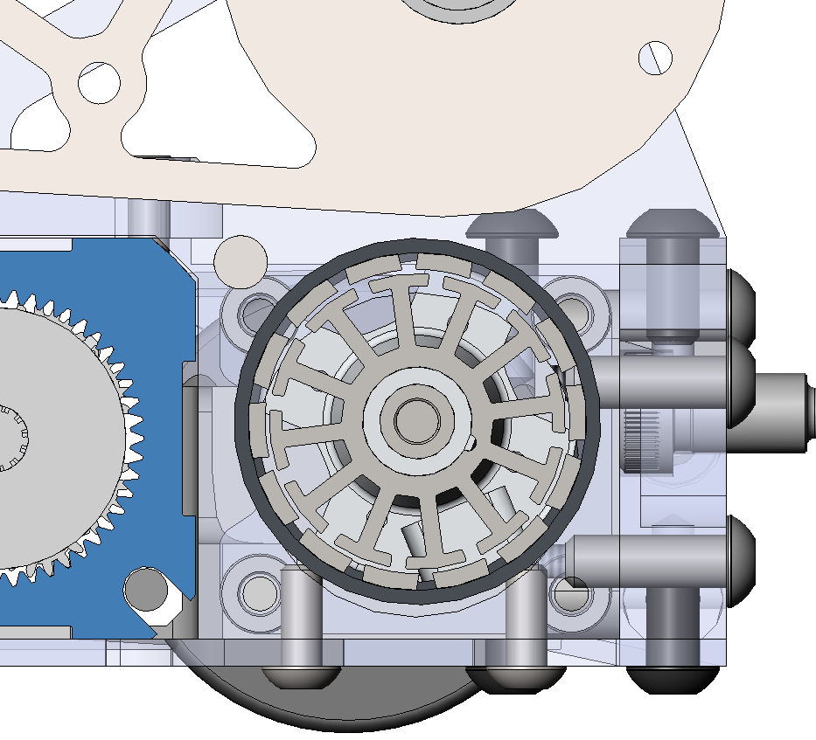
Package (BA3520)
Top plate interference
Recommendation:
- Extend chassis front-back size to make room
Screw interference
Motor shifted up:
Need to find appropriate belt c2c

Slide 14
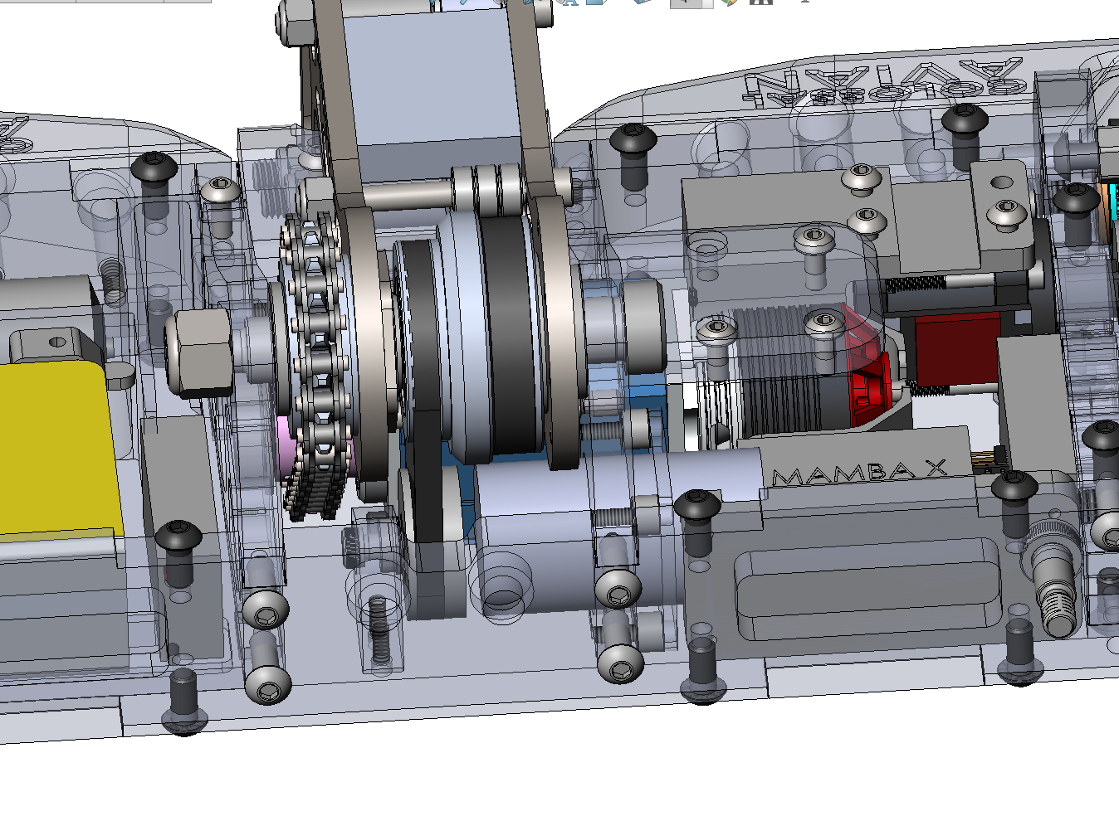
Package (TP 3630)
Rear support clamp mount in chassis
High KV motor requires more aggressive ratio
Front face mount plate

Slide 15
Chassis Design Changes

Slide 16
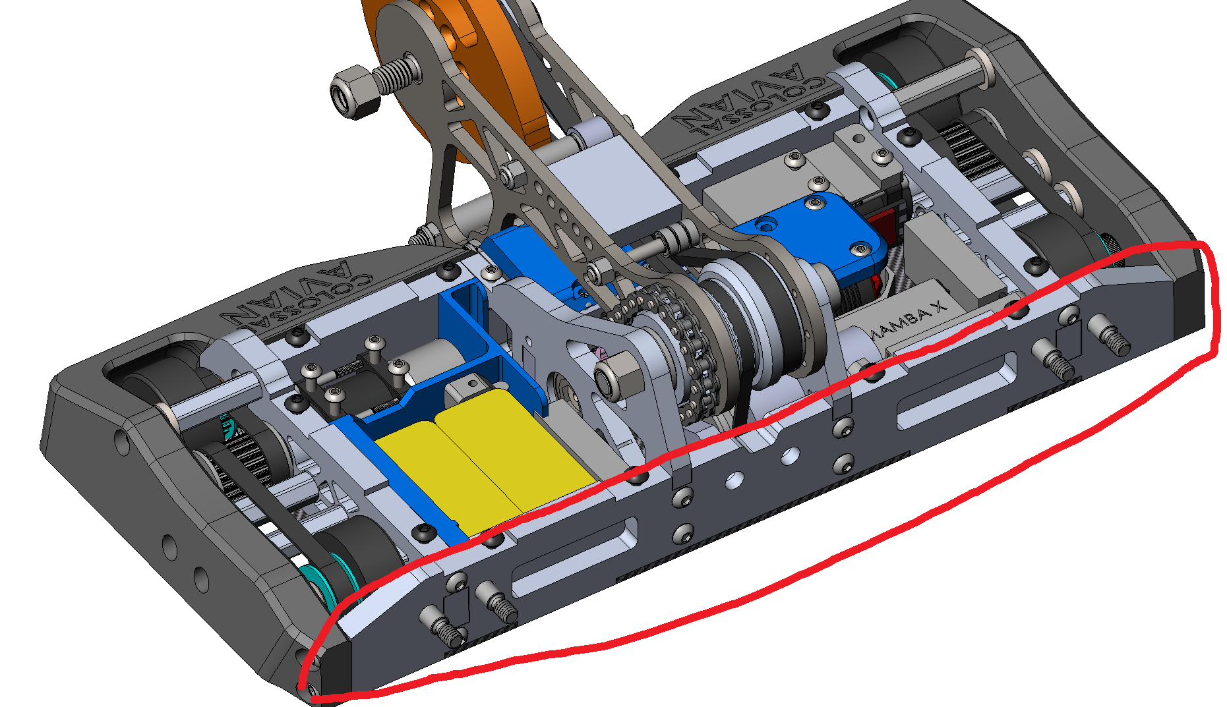
Front dimension increase
Maybe move front wheels up too, could improve balance/weight dist
Move front ~ 1/8” to make room for 3530 motor, batteries, etc

Slide 17
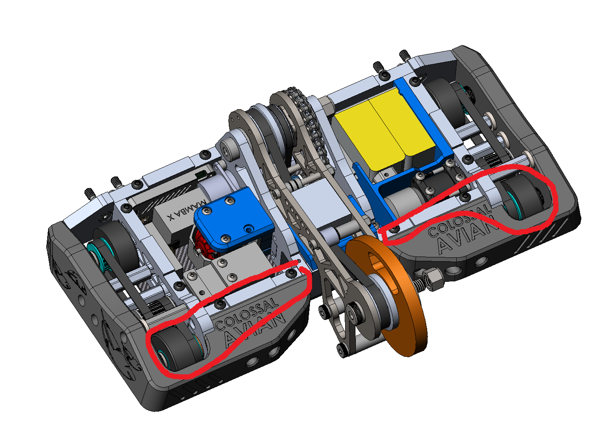
Rear dimension increase
Improves wheel – pulley clearance
Move rear wall + rear wheels ~1/8” rearward
Space gained for rear wiring-pass thru

Slide 18
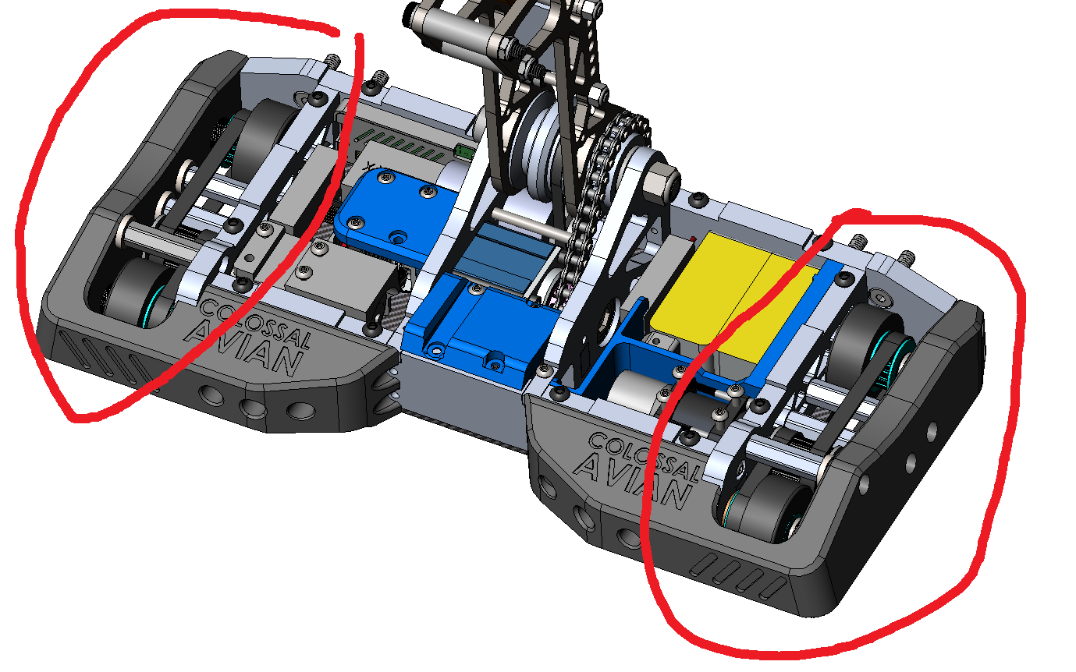
Side Dimension Increase
Move both sides by ~1/8” outwards to make room rhino ESC and other electronics

Slide 19
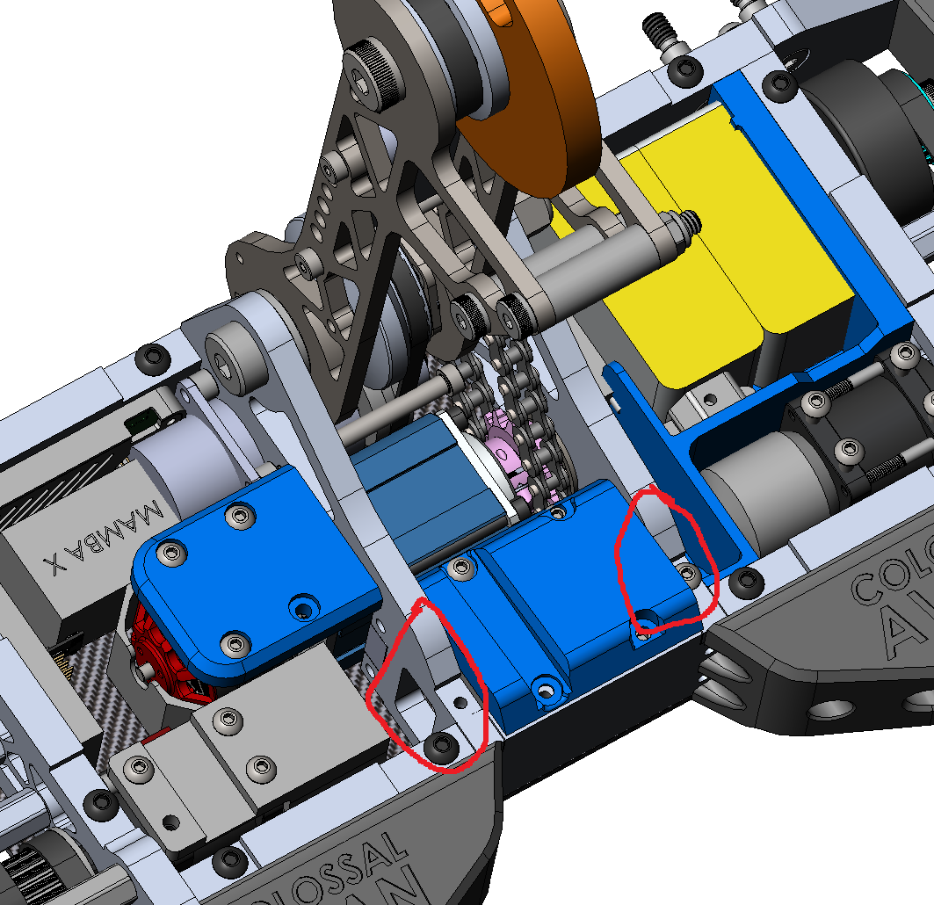
Remove Rear upright structure
Get rid of this???? Sucks for serviceability, questionable structural integrity
Maybe need to do more brainstorming on a smarter idea for this

Slide 20
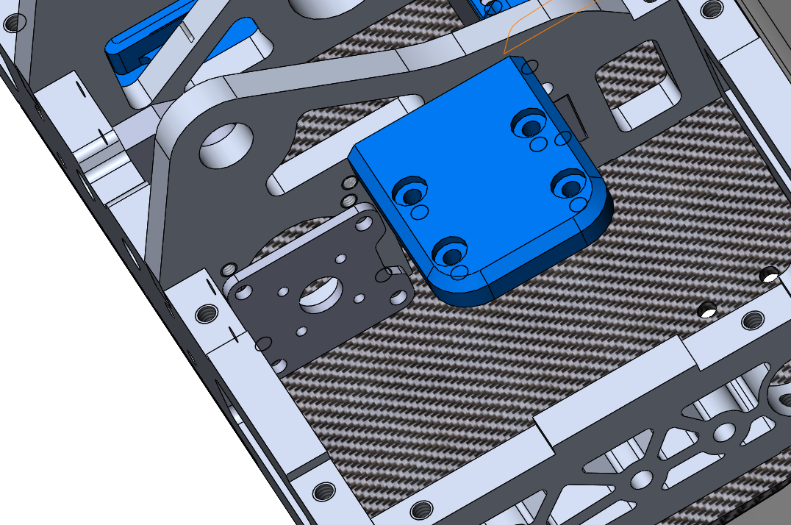
Wep Motor Mounting Plate
Make this a machined part so we don’t have to deal w the spacers
Cheap alternative: glue the spacers to the plate

Slide 21
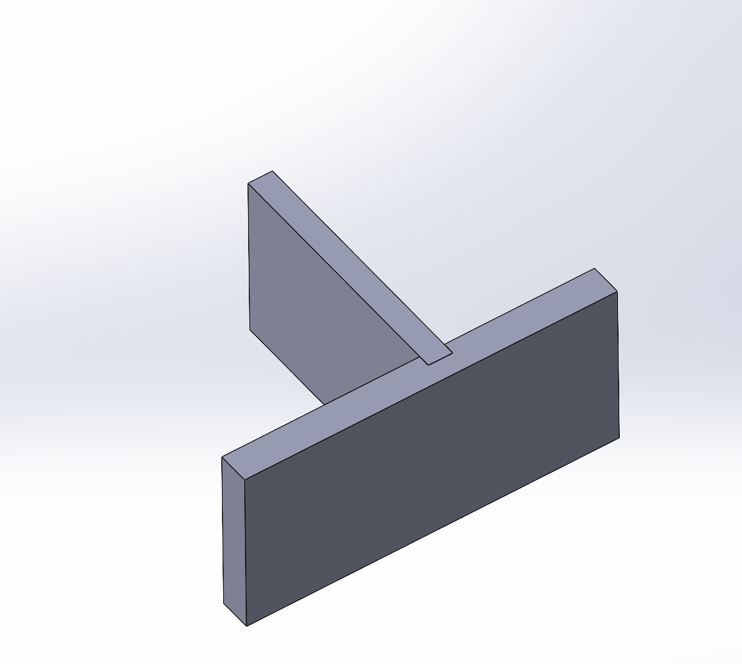
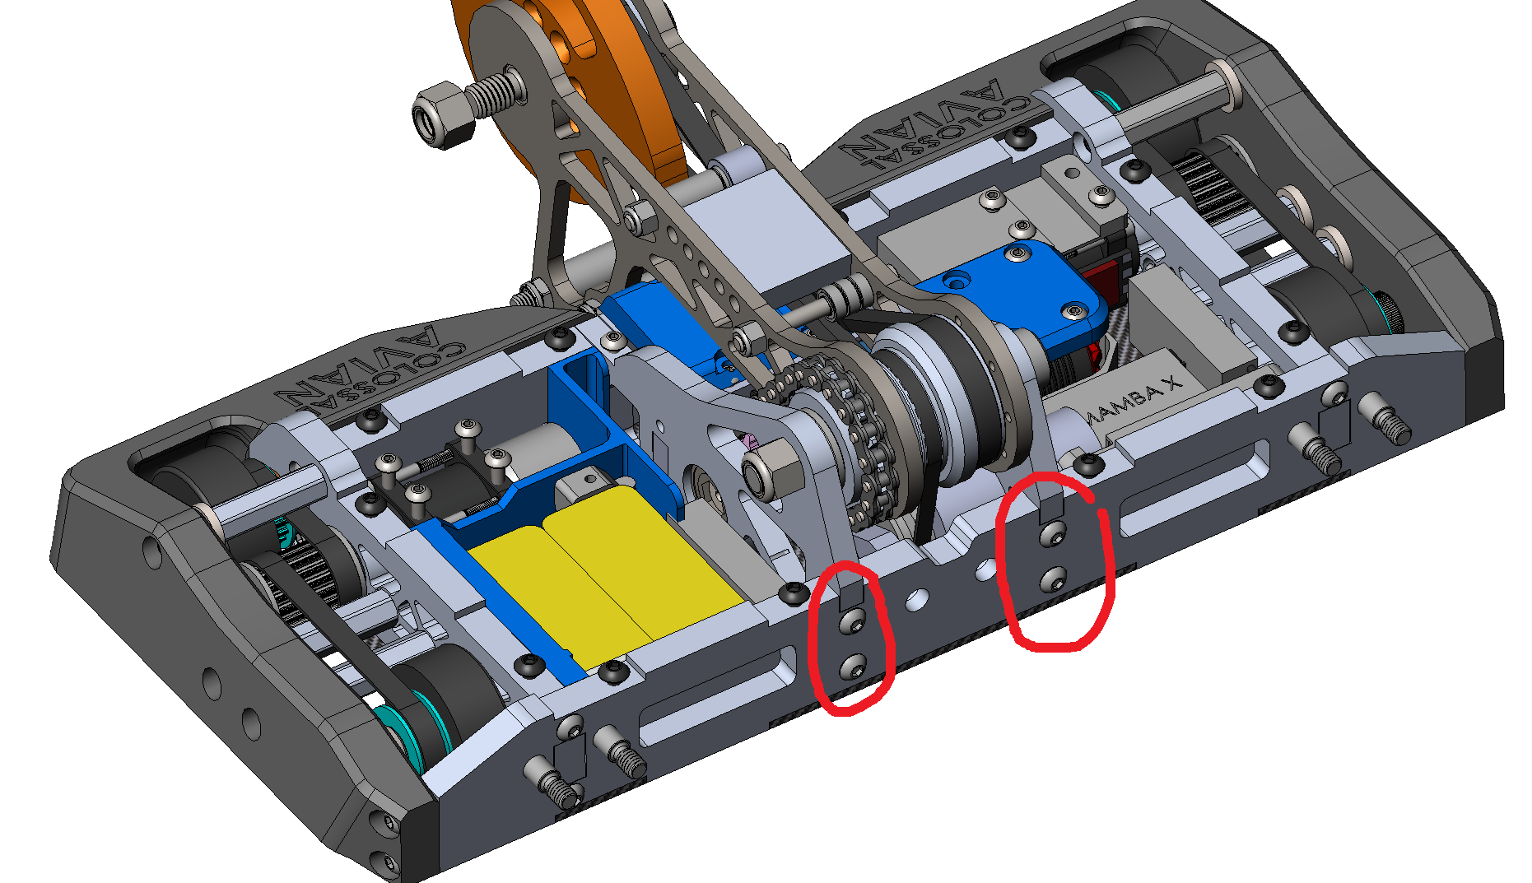
Dado Joint
+ Better support for upright alignment
+ Improved machinability

Slide 22
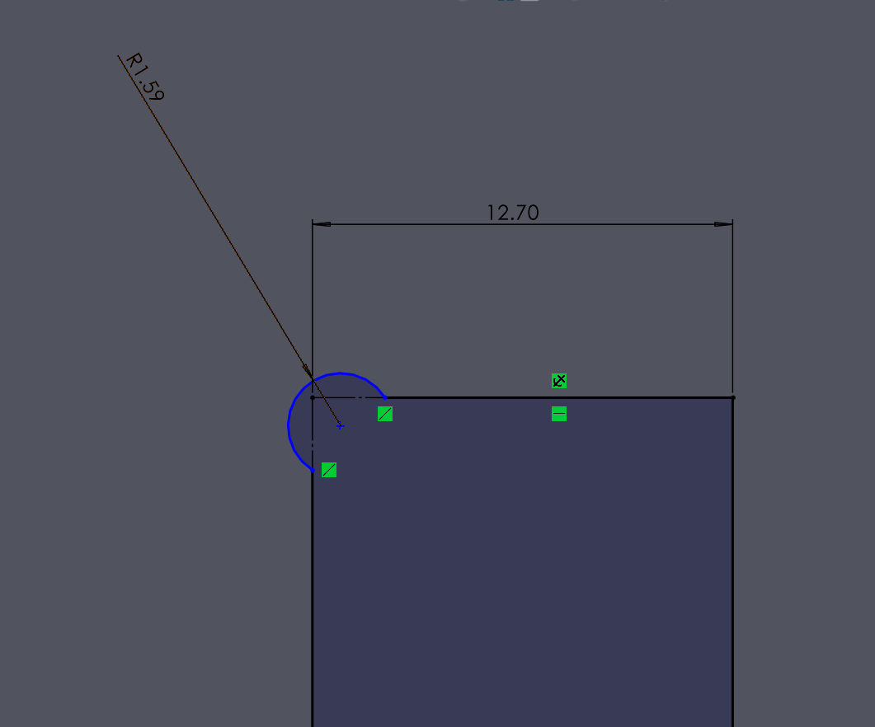
Mouse Ear Design
Allows 1/8” endmill

